Slide 1
Week Five Tic-Tac-Toe Simulator & 2D Arrays A Tutorial
The CSC221 Team
[2022|2023]

Slide 2
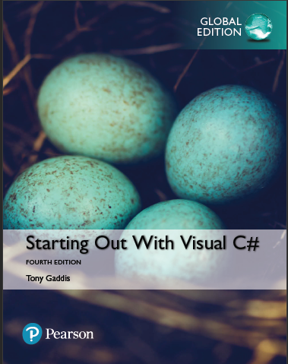
Main Text for this Course
Title
Starting out with Visual C#
Author
Tony Gaddis
Download for your progressive learning

Slide 3
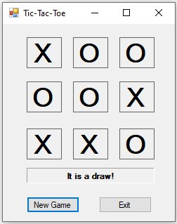
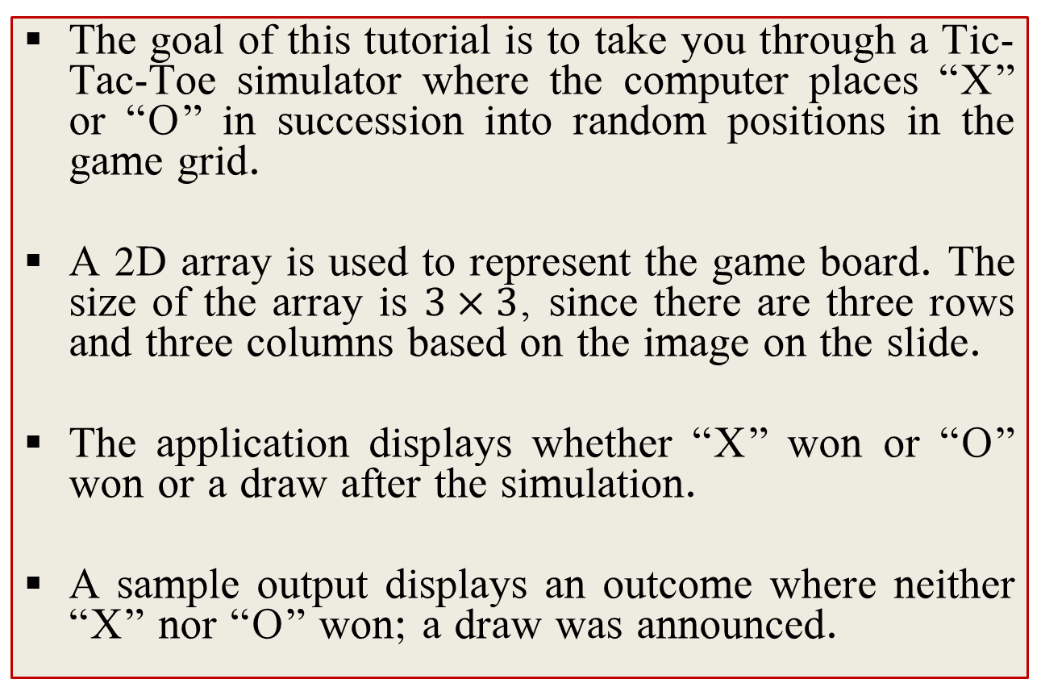
Preamble
The goal of this tutorial is to take you through a Tic-Tac-Toe simulator where the computer places “X” or “O” in succession into random positions in the game grid.
A 2D array is used to represent the game board. The size of the array is $3×3$, since there are three rows and three columns based on the image on the slide.
The application displays whether “X” won or “O” won or a draw after the simulation.
A sample output displays an outcome where neither “X” nor “O” won; a draw was announced.

Slide 4
SET-UP

Slide 5
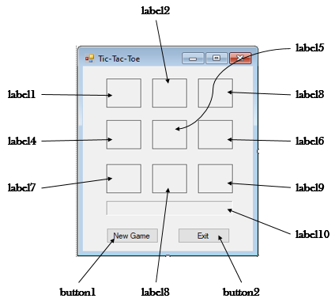
Designing the form

Slide 6
Properties of the Controls
Controls | Setting
Labels (1 – 9) | BorderStyle: FixedSingle Font: Bold, 28 pt Size: 50, 44 TextAlign: MiddleCenter
Label10 | BorderStyle: Fixed3D Font: Bold, 8 pt Size: 182, 22 TextAlign: MiddleCenter
Buttons | Default settings

Slide 7
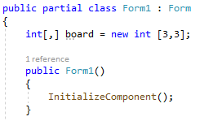
Initialize the Game Board
The game board is represented using a 2D array as declared below:
int[,] board = new int [3,3];
Because of its importance to all methods implemented in this project, the array is created as a global variable.
It is placed immediately after the class declaration (see image).

Slide 8
Codes/Explanations

Slide 9
fillArray method
void fillArray()
{
for(int i=0; i<3; i++)
{
for(int j=0; j<3; j++)
{
board[i, j] = 0;
}
}
}
Create a function called fillArray().
This function just fills the array with the cells with the default value (0).
It is called whenever a new game is about to be simulated.

Slide 10
Implementations of button1 and button2
private void button1_Click(object sender, EventArgs e)
{
simulate();
}
private void button2_Click(object sender, EventArgs e)
{
Application.Exit();
}
Clicking button1 triggers the simulate() function.
Clicking button2 simply exits the application.
The simulate() function runs the actual simulation of the tic-tac-toe game.

Slide 11
Implementation of the play(int, int, int) method
void play(int val, int row, int col){
board[row, col] = val;
if(row == 0 && col == 0)
label1.Text = (val == 1) ? "X" : "O";
else if(row == 0 && col == 1)
label2.Text = (val == 1) ? "X" : "O";
else if (row == 0 && col == 2)
label3.Text = (val == 1) ? "X" : "O";
else if (row == 1 && col == 0)
label4.Text = (val == 1) ? "X" : "O";
else if (row == 1 && col == 1)
label5.Text = (val == 1) ? "X" : "O";
else if (row == 1 && col == 2)
label6.Text = (val == 1) ? "X" : "O";
else if (row == 2 && col == 0)
label7.Text = (val == 1) ? "X" : "O";
else if (row == 2 && col == 1)
label8.Text = (val == 1) ? "X" : "O";
else
label9.Text = (val == 1) ? "X" : "O";
}
The function accepts three arguments.
First argument stores the value in the range [1, 2]; these are the only valid values to enter a cell.
1 represents “X” while 2 represents “O”
Second argument represents the row to be filled in the game board.
Third argument represents the column to be filled in the game board.

Slide 12
The play() method - explanation
The first line in the body of the function stores the value to be played (val) in the appropriate cell location of the 2D array.
The string “X” or “O” is displayed in an appropriate label based on the row and column indices passed into the function.
For example, if row = 0 and column = 0, then we displayed the string in the first label (label1).
Another example, if row = 2 and column = 0, then we displayed the string in the seventh label (label7).

Slide 13
The play() method – explanation (2)
Let’s explain one of the many similar statements in the method:
label2.Text = (val == 1) ? "X" : "O";
Its semantics is: “if val is equal to 1, then place “X” in label2, otherwise, place “O” in label2.
You should notice a pattern:
We map each cell location to a label control, such that when a value is played, it is placed in the right cell,
and then its string representation (“X” or ”O”) is displayed in the appropriate label.

Slide 14
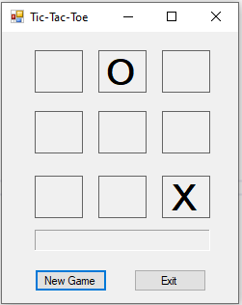
State of the game after two rounds
A call to (2, 0, 1) means “O” is placed in location [0, 1] => label2.
A call to (1, 2, 2) means “X” is placed in location [2, 2] => label9.
The states of the 2D array and the form after these two calls look like:
0 | 2 | 0
0 | 0 | 0
0 | 0 | 1

Slide 15
The check() method
Implement another method called check(). The function of this method is to check for a possible victory after five rounds of the game have been played.
The function takes two arguments:
bool check(int playedValue, int loc)
The parameter playedValue represents the current value played (1 or 2).
The parameter loc represents the location where the move was made.
Finally, the function returns a Boolean value indicating if the recent move caused a winner (“X” or “O”) to emerge.

Slide 16
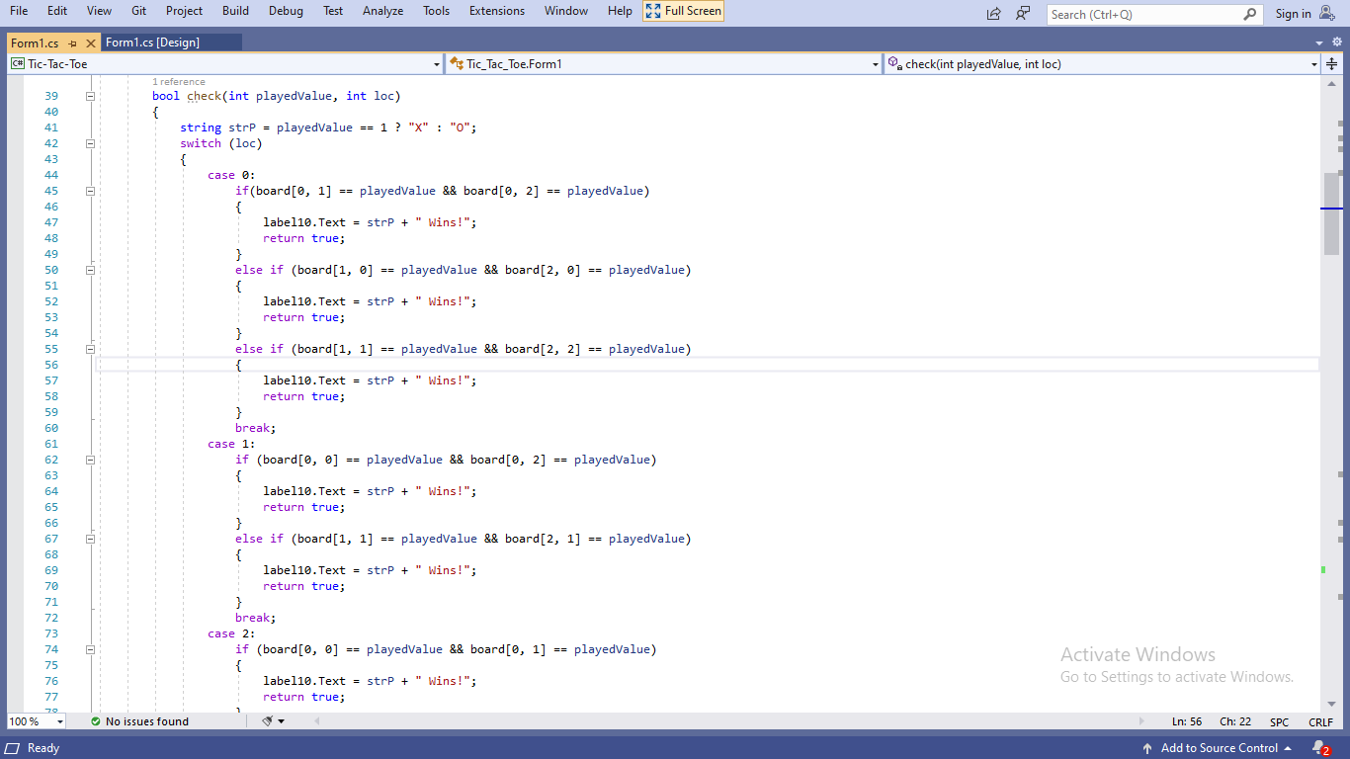
Partial view of the check method
You would notice we use a switch statement to implement the the main logic of this method.
The first line of the method’s body retrieves the string representation of the value being played.
If the value is 1, strP’s value will be “X”, otherwise, strP’s value will be “O”.
There are nine cases (case 0 to case 8), they are further explained in the next slide.

Slide 17
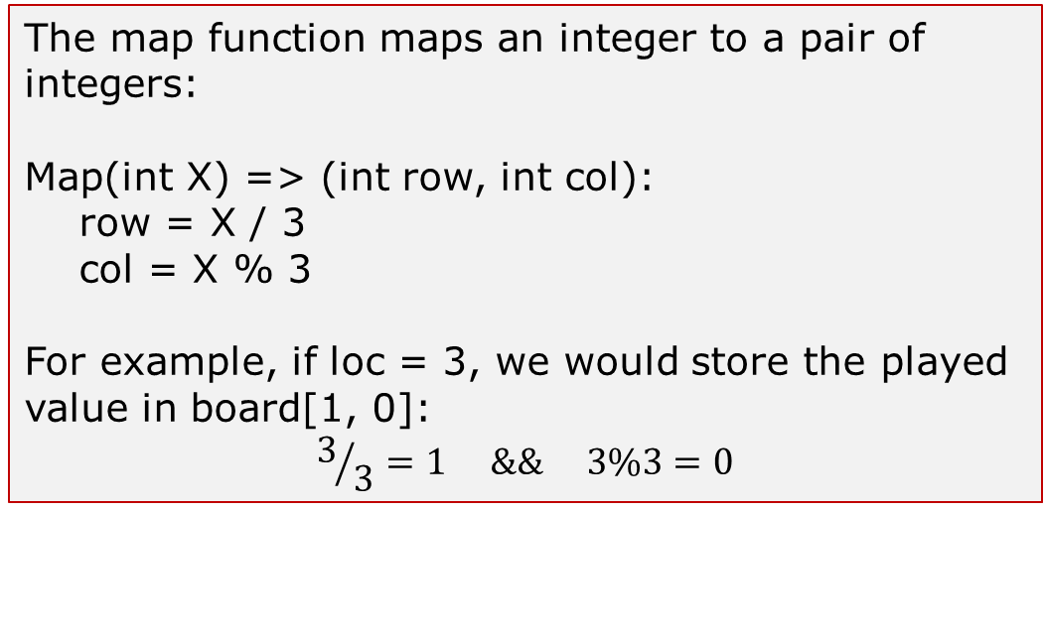
Mapping an integer to actual row and column indices of the game board.
There are nine locations in the board, using array indexing, we have locations 0 to 8.
Therefore, case 0 (when loc = 0) handles the situation whereby location 0 is the position the played value is to be placed. Similarly, case 2 (when loc = 2) means the played value is to placed in location 2.
The integer value has to be mapped to an actual location in the game board, this helps in knowing what array locations to check. See the description of the mapping below:
The map function maps an integer to a pair of integers:
Map(int X) => (int row, int col):
row = X / 3
col = X % 3
For example, if loc = 3, we would store the played value in board[1, 0]:
$$3/3=1 \&\& 3\%3=0$$
Map(0) = (0, 0); 0 / 3 = 0; 0 % 3 = 0
Map(1) = (0, 1); 1 / 3 = 0; 1 % 3 = 1
…
Map(8) = (2, 2); 8 / 3 = 2; 8 % 3 = 2
0 | 1 | 2
3 | 4 | 5
6 | 7 | 8
0, 0 | 0, 1 | 0, 2
1, 0 | 1, 1 | 1, 2
2, 0 | 2, 1 | 2, 2

Slide 18
Case 0
case 0: // when loc = 0; then row = 0 and col = 0
if(board[0, 1] == playedValue && board[0, 2] == playedValue)
{
label10.Text = strP + " Wins!";
return true;
}
else if (board[1, 0] == playedValue && board[2, 0] == playedValue)
{
label10.Text = strP + " Wins!";
return true;
}
else if (board[1, 1] == playedValue && board[2, 2] == playedValue)
{
label10.Text = strP + " Wins!";
return true;
}
break;
0, 0 | 0, 1 | 0, 2
1, 0 | 1, 1 | 1, 2
2, 0 | 2, 1 | 2, 2
For case 0, check the horizontal, vertical and diagonal entries

Slide 19
Case 1
case 1: // when loc = 1; then row = 0 and col = 1
if (board[0, 0] == playedValue && board[0, 2] == playedValue)
{
label10.Text = strP + " Wins!";
return true;
}
else if (board[1, 1] == playedValue && board[2, 1] == playedValue)
{
label10.Text = strP + " Wins!";
return true;
}
break;
0, 0 | 0, 1 | 0, 2
1, 0 | 1, 1 | 1, 2
2, 0 | 2, 1 | 2, 2
For case 1, check the horizontal and vertical entries

Slide 20
Case 2
case 2: // when loc = 2; then row = 0 and col = 2
if (board[0, 0] == playedValue && board[0, 1] == playedValue)
{
label10.Text = strP + " Wins!";
return true;
}
else if (board[1, 2] == playedValue && board[2, 2] == playedValue)
{
label10.Text = strP + " Wins!";
return true;
}
else if (board[1, 1] == playedValue && board[2, 0] == playedValue)
{
label10.Text = strP + " Wins!";
return true;
}
break;
break;
0, 0 | 0, 1 | 0, 2
1, 0 | 1, 1 | 1, 2
2, 0 | 2, 1 | 2, 2
For case 2, check the horizontal, vertical and diagonal entries

Slide 21
Case 3
case 3: // when loc = 3; then row = 1 and col = 0
if (board[1, 1] == playedValue && board[1, 2] == playedValue)
{
label10.Text = strP + " Wins!";
return true;
}
else if (board[0, 0] == playedValue && board[2, 0] == playedValue)
{
label10.Text = strP + " Wins!";
return true;
}
break;
0, 0 | 0, 1 | 0, 2
1, 0 | 1, 1 | 1, 2
2, 0 | 2, 1 | 2, 2
For case 3, check the horizontal and vertical entries

Slide 22
Case 4
case 4: // when loc = 4; then row = 1 and col = 1
if (board[0, 1] == playedValue && board[2, 1] == playedValue)
{
label10.Text = strP + " Wins!";
return true;
}
else if (board[1, 0] == playedValue && board[1, 2] == playedValue)
{
label10.Text = strP + " Wins!";
return true;
}
else if (board[0, 2] == playedValue && board[2, 0] == playedValue)
{
label10.Text = strP + " Wins!";
return true;
}
else if (board[0, 0] == playedValue && board[2, 2] == playedValue)
{
label10.Text = strP + " Wins!";
return true;
}
break;
For case 4, check the two diagonal entries, vertical and horizontal entries
0, 0 | 0, 1 | 0, 2
1, 0 | 1, 1 | 1, 2
2, 0 | 2, 1 | 2, 2

Slide 23
Case 5
case 5: // when loc = 5; then row = 1 and col = 2
if (board[0, 2] == playedValue && board[2, 2] == playedValue)
{
label10.Text = strP + " Wins!";
return true;
}
else if (board[1, 0] == playedValue && board[1, 1] == playedValue)
{
label10.Text = strP + " Wins!";
return true;
}
break;
0, 0 | 0, 1 | 0, 2
1, 0 | 1, 1 | 1, 2
2, 0 | 2, 1 | 2, 2
For case 5, check the horizontal and vertical entries

Slide 24
Case 6
case 6: // when loc = 6; then row = 2 and col = 0
if (board[0, 0] == playedValue && board[1, 0] == playedValue)
{
label10.Text = strP + " Wins!";
return true;
}
else if (board[2, 1] == playedValue && board[2, 2] == playedValue)
{
label10.Text = strP + " Wins!";
return true;
}
else if (board[1, 1] == playedValue && board[0, 2] == playedValue)
{
label10.Text = strP + " Wins!";
return true;
}
break;
break;
0, 0 | 0, 1 | 0, 2
1, 0 | 1, 1 | 1, 2
2, 0 | 2, 1 | 2, 2
For case 6, check the horizontal, vertical and diagonal entries

Slide 25
Case 7
case 7: // when loc = 7; then row = 2 and col = 1
if (board[0, 1] == playedValue && board[1, 1] == playedValue)
{
label10.Text = strP + " Wins!";
return true;
}
else if (board[2, 0] == playedValue && board[2, 2] == playedValue)
{
label10.Text = strP + " Wins!";
return true;
}
break;
0, 0 | 0, 1 | 0, 2
1, 0 | 1, 1 | 1, 2
2, 0 | 2, 1 | 2, 2
For case 7, check the horizontal and vertical entries

Slide 26
Case 8
case 8: // when loc = 8; then row = 2 and col = 2
if (board[0, 0] == playedValue && board[1, 1] == playedValue)
{
label10.Text = strP + " Wins!";
return true;
}
else if (board[0, 2] == playedValue && board[1, 2] == playedValue)
{
label10.Text = strP + " Wins!";
return true;
}
else if (board[2, 0] == playedValue && board[2, 1] == playedValue)
{
label10.Text = strP + " Wins!";
return true;
}
break;
break;
0, 0 | 0, 1 | 0, 2
1, 0 | 1, 1 | 1, 2
2, 0 | 2, 1 | 2, 2
For case 8, check the horizontal, vertical and diagonal entries

Slide 27
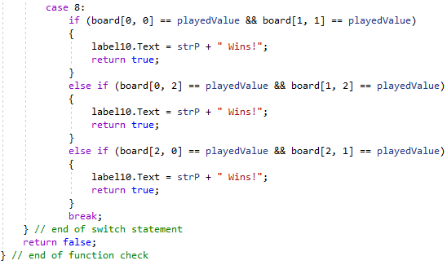
Wrap-up – check function
After case 8, we have the following:
The closing curly brace for the switch statement
Immediately followed by the following code:
return false;
Lastly, the closing curly brace for the function.
The “return false” statement executes only if none of the conditions in the series of if-else blocks of the case label evaluates to true.
If a winner emerges, an appropriate message is displayed in label10 using the stored value in strP.

Slide 28
The simulate() method
This is the last and the most important method to be implemented. It controls the main logic of the Tic-Tac-Toe simulation.
The structure of the method reads:
private void simulate()
{
// function body
// place the codes in subsequent slides here
}

Slide 29
The simulate method – Part I
Random rnd = new Random();
int value_to_play = rnd.Next(1, 3);
foreach(var control in this.Controls) // iterate through all controls in the form
{
if(control is Label)
{
Label l = (Label)control;
l.Text = "";
}
}
List<int> locations = new List<int>() { 0, 1, 2, 3, 4, 5, 6, 7, 8 };
fillArray();

Slide 30
Part I - Explanation
Random rnd = new Random(); simply creates a new instance (an object) of the Random class. This is needed to randomize some operations.
The next expression:
int value_to_play = rnd.Next(1, 3);
Randomly generates a number between 1 and 2 (both inclusive) via the rnd object created in the previous line.
The foreach loop block clears the content of all the label controls (further explanation on the next slide).

Slide 31
Part I – Explanation (2)
To clear all the labels, we do the following:
Iterate through all controls in the form (referred to as “this”) using the foreach loop;
Check if the control is a label control (this is necessary since we have button (other) controls in the form);
Create an instance of a label by casting the variable control (which is of type var and not Label) as a label:
A label object (l) is created to point to control and share its properties.
Clear the label (l) by setting its Text property to empty string.

Slide 32
Part I – Explanation (3)
List<int> locations = new List<int>() { 0, 1, 2, 3, 4, 5, 6, 7, 8 };
The code above creates a new List collection of integers containing the values 0 … 8
These values represent the nine locations in the game board
Finally, we call the fillArray() method. Why?
This is to re-initialize the cells of the 2D array (board) to 0 since the previous game had caused the majority of the array cells to be filled with values (1 or 2).
More like, a reset of the game board is done

Slide 33
The simulate method – Part II – Continuation of the codes in Part I
while (locations.Count > 0)
{
int loc_position = rnd.Next(0, locations.Count);
int loc = locations[loc_position];
int row = loc / 3;
int col = loc % 3;
play(value_to_play, row, col);
locations.RemoveAt(loc_position);
if (locations.Count <= 4)
{
if (check(value_to_play, loc))
return;
}
value_to_play = (value_to_play == 1) ? 2 : 1;
}
label10.Text = "It is a draw!";

Slide 34
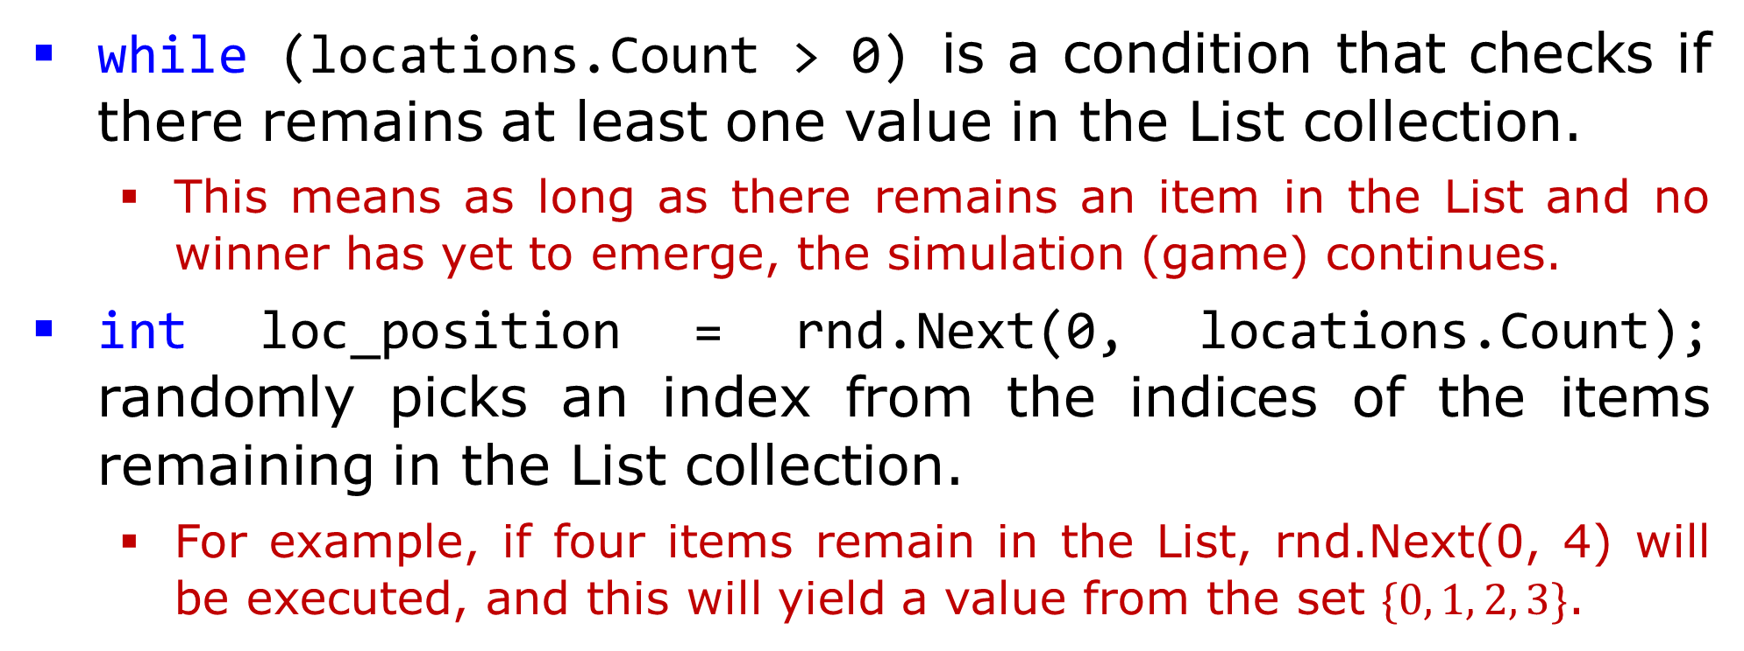
Part II - Explanation
while (locations.Count > 0) is a condition that checks if there remains at least one value in the List collection.
This means as long as there remains an item in the List and no winner has yet to emerge, the simulation (game) continues.
int loc_position = rnd.Next(0, locations.Count); randomly picks an index from the indices of the items remaining in the List collection.
For example, if four items remain in the List, rnd.Next(0, 4) will be executed, and this will yield a value from the set $\{0, 1, 2, 3\}$.

Slide 35
Part II – Explanation (2)
The next four lines:
int loc = locations[loc_position];
int row = loc / 3;
int col = loc % 3;
play(value_to_play, row, col);
Retrieves the item from the index location randomly generated in the previous slide.
Maps the value of loc to actual row and column indices in the 2D array (board) – see the map function explanation in slide 17.
Call the play function – see slides 11 to 14 to execute the move.

Slide 36
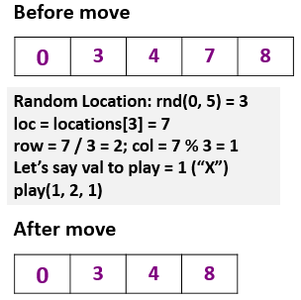
Part II – Explanation (3)
The line that follow:
locations.RemoveAt(loc_position);
Calls the RemoveAt method of List to remove the item at the location passed as the argument to the method call.
This makes sense, since we do not intend to play in the current location that we just made a move to.
Illustration of List content before and after a move is provided in the slide.

Slide 37
Part II – Explanation (4)
The following block:
if (locations.Count <= 4)
{
if (check(value_to_play, loc))
return;
}
Checks if we have at most four items in the List; at this stage, it means that at least five moves have been made, then we can check for a winner.
If the outer if statement is true, we call the check function to see if the move just made led to a winner. If that is true, we return; meaning – end the simulation.

Slide 38
Part II – Wrap-up
value_to_play = (value_to_play == 1) ? 2 : 1; just alternates between 1 and 2.
If the value of value_to_play is 1, it changes to 2;
Otherwise, it means the value is currently 2, and in this case, it changes to 1.
label10.Text = "It is a draw!"; simply announces a draw at the end of the while loop
This can only happen when a winner fails to emerge after nine moves (the inner if statement in slide 37 does not execute) and the List empties out.

